Slide 1
Annual Conference of Directors General of Customs in the West and Central Africa Region
Banjul, from 04 to 05 May 2023
The integration of Cameroonian Customs into the National Defence and Security Community: an adjunct to the security sector reform process in Cameroon
Presentation:
FONGOD EDWIN NUVAGA
Director General of Cameroon Customs

Slide 2
OUTLINE OF THE PAPER
Background;
Security Sector Reform (SSR): An opportunity to legitimise Customs in the security field;
The determinants of the positioning of Cameroonian customs in the security field in Cameroon and the options taken by the State;
Constraints and challenges.

Slide 3
BACKGROUND AND RATIONALE
THE IMPLEMENTATION OF THE PUNTA CANA RESOLUTION 2015.
«THE SURVEILLANCE FORUM" from 10 to 11 August 2020 at NOMAYOS
THE MULTIPLICATION OF FRAGILE BORDERS IN CAMEROON

Slide 4
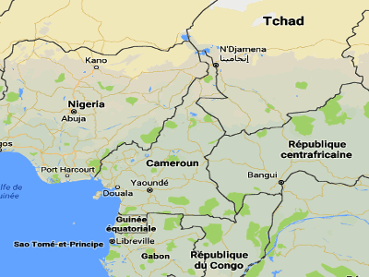
BACKGROUND AND RATIONALE
Situated on the Gulf of Guinea, Cameroon faces in some respects the persistence of belligerence in the North West, South West and Far North regions, as well as criminality in the Adamaoua, North and East regions.
520 kilometres of border with the Republic of Congo;
183 kilometres with Equatorial Guinea;
298 kilometres with Gabon;
1122 kilometres of border with Chad;
822 Kilometers with the Central African Republic;
1720 Kilometers of border with Nigeria, of which 590 kilometres on the Atlantic coast.
TENSION OUTBREAKS AND ATTACKS ON EEI
On the national level

Slide 5
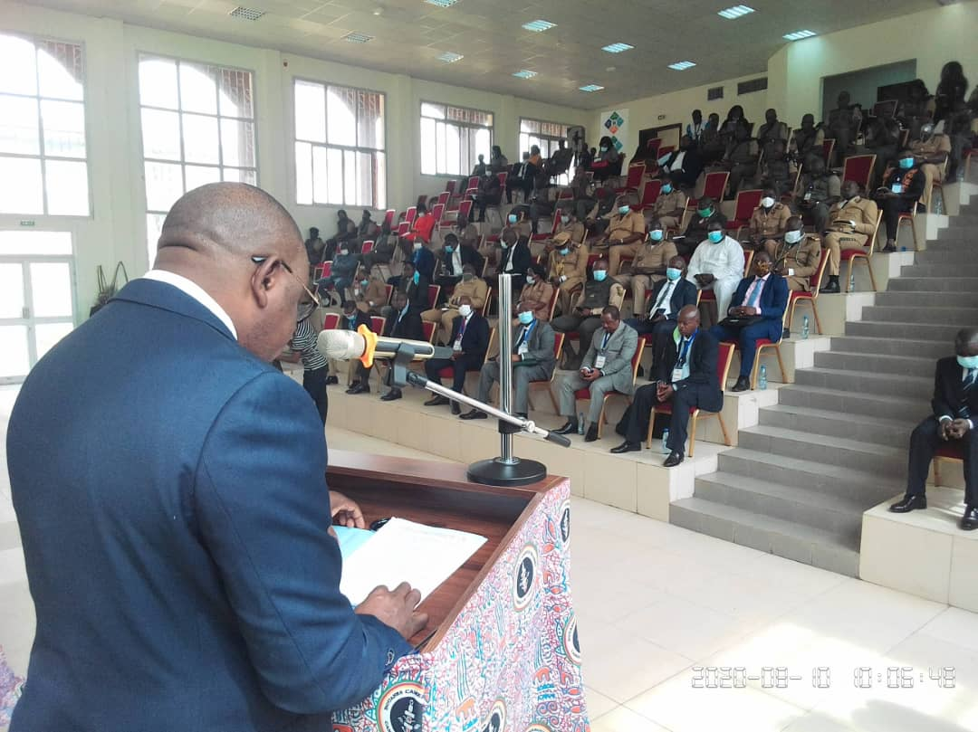
BACKGROUND AND RATIONALE
On the national level
Thus, perceiving the dangers of the hibernation of the surveillance mission and the multiplication of these hot spots along the land and maritime borders of Cameroon, the General Directorate of Customs has undertaken the elaboration of a plan for the refoundation of surveillance and the revitalization of active units, through exchange days called "FORUM of Surveillance", in August 2020 at the Customs Training Centre of Cameroon, on the issue of customs surveillance.

Slide 6
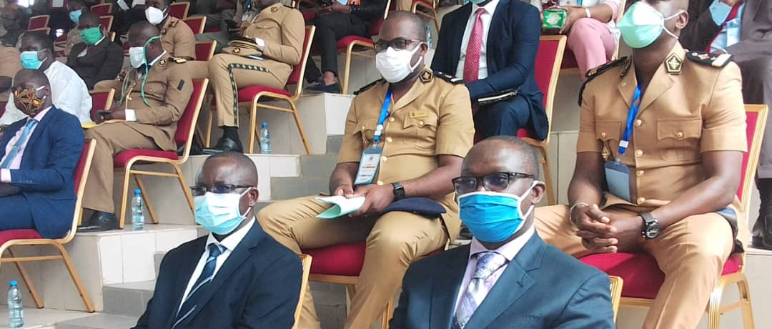
BACKGROUND AND RATIONALE
On the national level
The aim of these meetings was not only to analyse and consolidate the sectoral surveillance plans of the units, but also to define the lines of action likely to make it possible to take up the challenges of security and protection of the economic area by means of the reflections on the subject:
the structuring of information processing and the intelligence circuit ;
Deployment of the water monitoring system for airport port platforms and land-based perimeters;
Coordination of surveillance ;
Dynamisation of units ;
Monitoring and evaluation of units.

Slide 7
BACKGROUND AND RATIONALE
On the international level
Taking into account the various UN resolutions, notably Resolution 1540 and the Punta Cana resolution of December 2015, regarding the role of customs in the context of security and the Safe Framework of Standards to secure and facilitate international trade.
Indeed, in a context of security dilation due to the effects of the expansion of direct threats and the sedimentation of insecurity, states, communities and individuals deploy both panoptic (security for all) and synoptic (selective security) measures, depending on the context, through mechanisms ranging from the most basic to conventional methods of meshing and squaring the territory.

Slide 8
SECURITY SECTOR REFORM: AN OPPORTUNITY TO LEGITIMISE CAMEROON CUSTOMS IN THE SECURITY FIELD
IN EFFECT
The notion of "security", long considered strictly from the point of view of protecting states from military threats, has evolved towards the well-being of citizens. This change has a profound impact on the way threats are conceived. Indeed, with SSR, the notion of security encompasses not only traditional military threats, but also what is now called 'human security' or, to use a terminology closer to home, the protection of society.

Slide 9
RSS: AN OPPORTUNITY TO LEGITIMISE CAMEROON CUSTOMS IN THE SECURITY FIELD
By intercepting products that pose a threat to security
Seizures of dual-use goods
Seizure of arms, ammunition and explosives

Slide 10
RSS: AN OPPORTUNITY TO LEGITIMISE CAMEROON CUSTOMS IN THE SECURITY FIELD
By optimising forward intelligence
Denunciation of suspicious movements,
Filing of suspicious transaction reports

Slide 11
SECURITY SECTOR REFORM: AN OPPORTUNITY TO LEGITIMISE CAMEROON CUSTOMS IN THE SECURITY FIELD
By optimising revenue collection, developing borders and ensuring that human security missions are carried out effectively
Fighting pharmaceutical crime
Fighting for consumer health protection
Fighting for environmental protection
Combating CITES violations
Fighting for the protection of the health of companies

Slide 12
RSS: AN OPPORTUNITY TO LEGITIMISE CAMEROON CUSTOMS IN THE SECURITY FIELD
By intensifying collaboration and cooperation initiatives
Informal collaboration through community policing
Formal collaboration through the formalisation of exchange platforms with the various stakeholders in the control chain

Slide 13
DETERMINANTS OF THE LEGITIMACY OF THE CUSTOMS' POSITION IN THE SECURITY FIELD
The WCO's strategic approach
Implementation of the security program
The implementation of secure communication and anti-fraud tools
Fragile borders programmes »
Special Operations
Anti-fraud online training tools

Slide 14
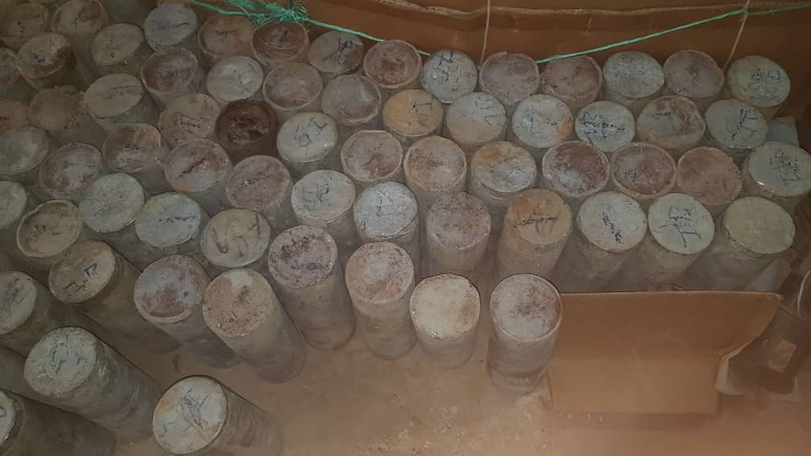
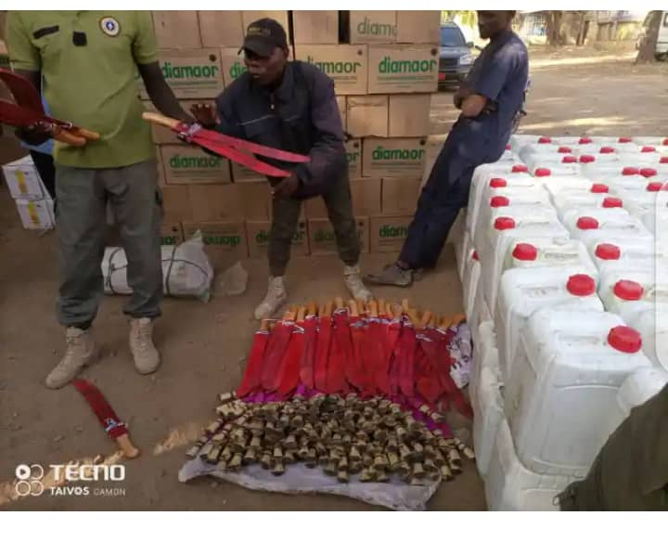
SOME FORECLOSURES RECORDED FROM 2020 TO 2023
Weapons, ammunition and explosives
Commodity nature | kg | Litres | Parts
Other weapons - Knives |  |  | 16 980
Ammunition - Firearms |  |  | 9 425
Parts of an explosive device - homemade charges |  |  | 357
Explosive precursors - Potassium chlorate | 2 175
Explosive precursors - Aluminium paste/powder/flakes | 437
Explosive precursors - Hydrogen peroxide |  | 75
Explosive precursors - Urea | 2 250
Species protected by the CITES convention
Commodity nature | kg | Litres | Parts
Other CITES products (panther teeth and claws, goliath frogs, albino peacocks, etc.) | 4 |  | 262,00
Dried chameleons |  |  | 1 234
Crocodiles | 6,50 |  | 4
Elephant tusks | 1 253,50
Pangolin scales | 200
Red-tailed parrots |  |  | 9
207 homemade explosive charges seized on 29/08/2020 in PAKETE (Extreme-nord)
10,000 knives and 5,000 machetes seized in Mora (Far North) in November 2021

Slide 15
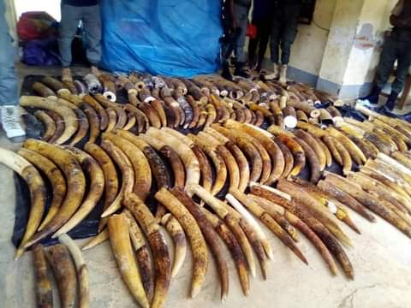
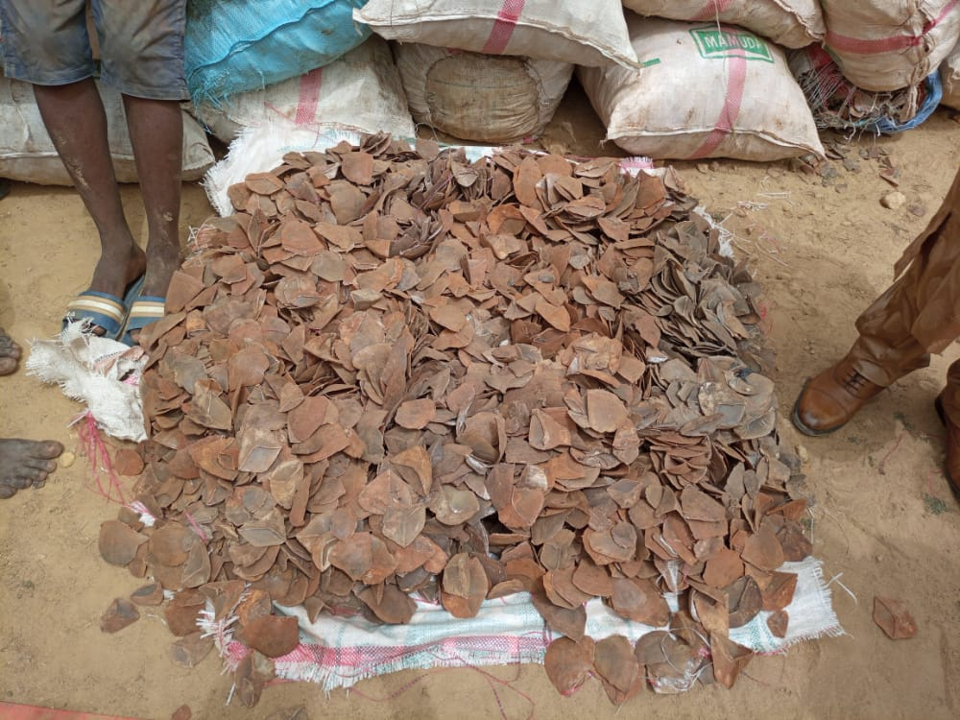
SUMMARY OF SEIZURES 2020-2023
Drugs and Psychotropic Products
Commodity nature | kg | Litres | Parts
Cannabis | 3 621,15
Cocaine | 103,77
New psychoactive substances (Ketamine) | 2,58
Psychotropic substances (Tramadol, Diazepam) | 9 |  | 115 590
Medicines and Pharmaceuticals
Commodity nature | kg | Litres | Parts
Medication (antimalarials, antibiotics, painkillers, erectile dysfunction, anti-inflammatory, etc.) | 15000 | 75 | 8 092 416
Food supplements (e.g. vitamins, herbal products) | 178 |  | 684 940
Seringues |  |  | 12 200
Vaccines |  |  | 16 100
Other Prohibitions and restrictions
Commodity nature | kg | Litres | Parts
Counterfeit |  |  | 11 695
Currencies (Euro) |  |  | 40 300
Non-biodegradable plastics | 17 002
Precious metals (gold) | 100,10
626 kg of ivory tips hidden in a van seized on 22/10/2020 in Ambam (South)
4400 kg of pangolin scales seized in Gashiga (North), in a semi-trailer bound for Nigeria

Slide 16
DETERMINANTS OF THE LEGITIMACY OF THE CUSTOMS' POSITION IN THE SECURITY FIELD
Options taken by the State and initiatives undertaken by the Directorate General of Customs
Participation in public safety meetings ;
Integration into the national defence and security community ;
The inclusion of targeted objectives in programme 032 of the NDS30 ;
The creation of trading centres;
The creation of the Juxtaposed Customs Offices;
The establishment of CAATs ;

Slide 17
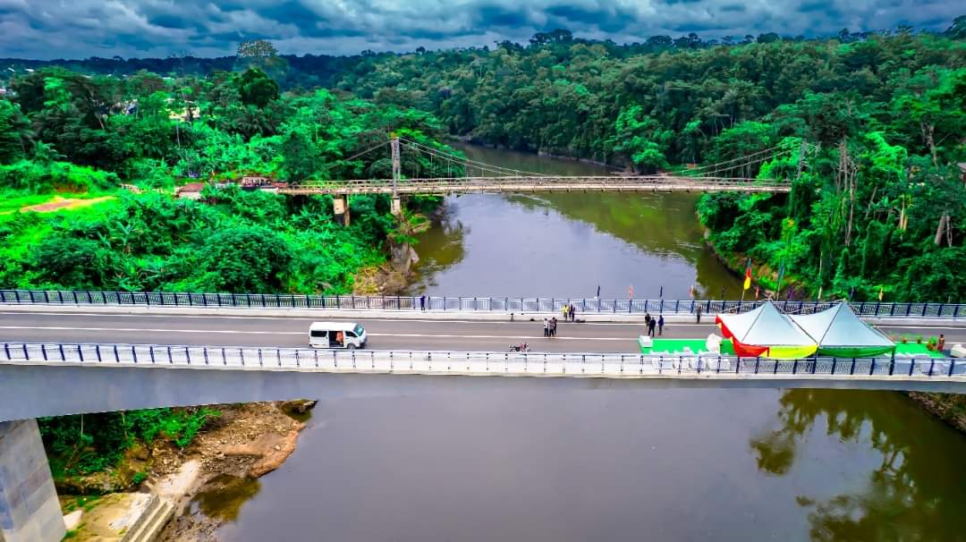
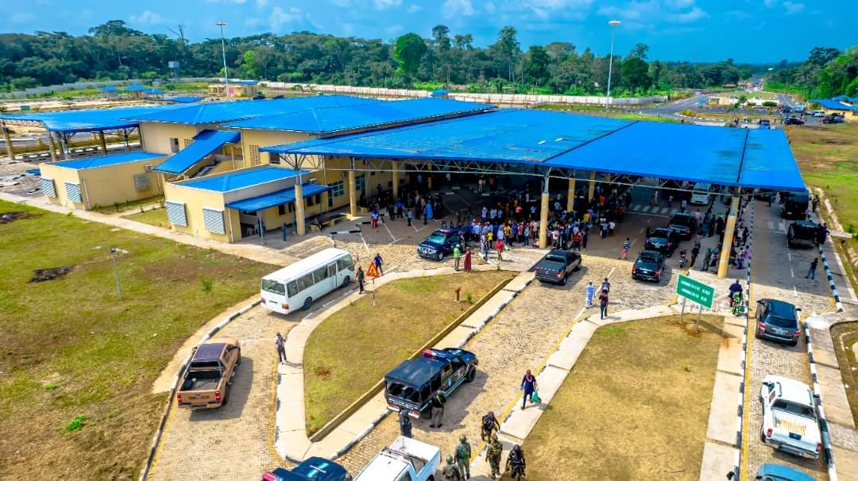
Inauguration of the bridge over the Cross River linking Cameroon and Nigeria

Slide 18
DETERMINANTS OF THE LEGITIMACY OF THE CUSTOMS' POSITION IN THE SECURITY FIELD
Options taken by the State and initiatives undertaken by the Directorate General of Customs
Registration for the SPC++ programme;
The creation of joint interstate brigades;
The regular organisation of refresher courses in the handling of weapons and ammunition, coupled with shooting exercises;
The regular organisation of tightly ordered refresher courses;
Membership of the Global Shield programme ;
The establishment of CAATs ;

Slide 19
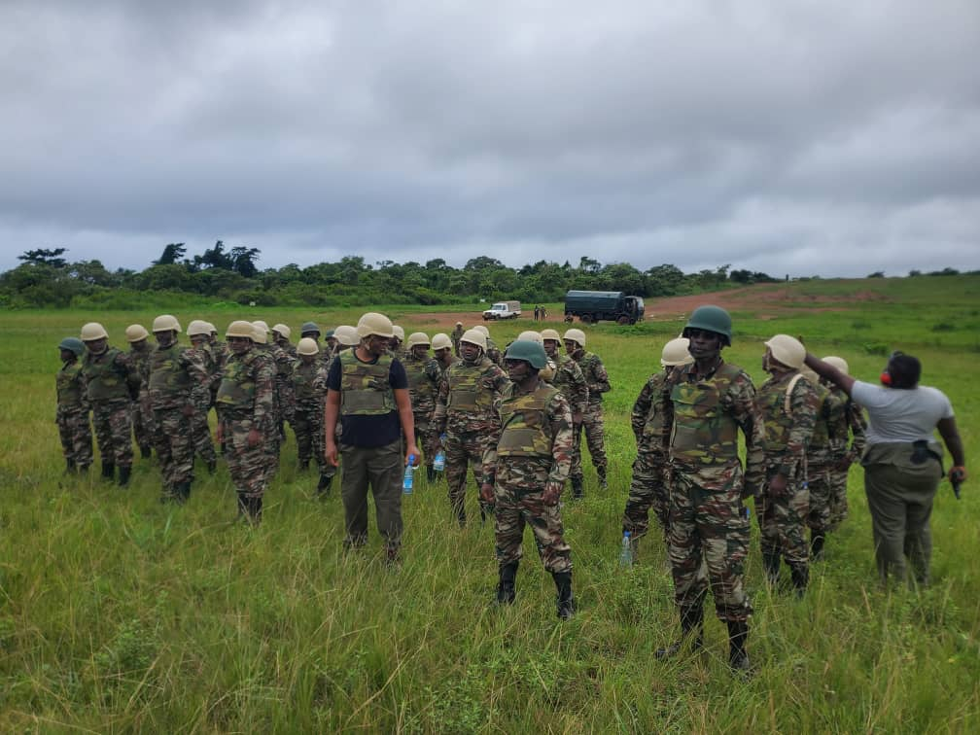
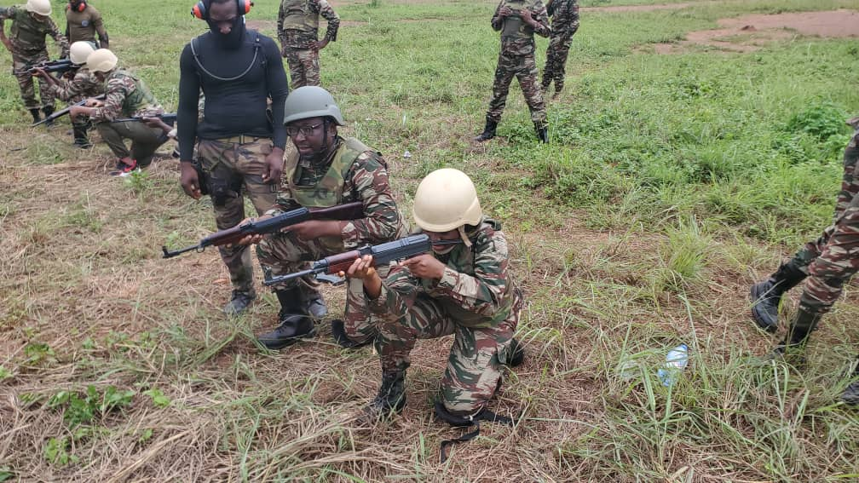
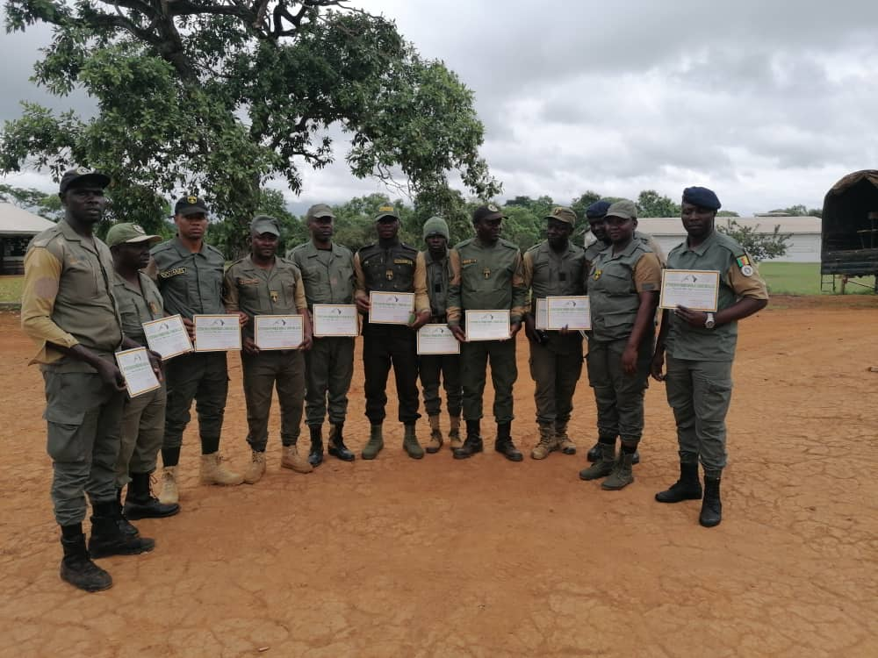
A SHOOTING EXERCISE ORGANISED IN COLLABORATION WITH THE ARMY

Slide 20
DETERMINANTS OF THE LEGITIMACY OF THE CUSTOMS' POSITION IN THE SECURITY FIELD
Options taken by the State and initiatives undertaken by the Directorate General of Customs
The reorganisation of the General Directorate of Customs in order to fully assume its security missions; ;
The development of a special statute to strengthen the negotiating power of the Customs;
The development of a disciplinary regulation for the Customs Administration, with a view to strengthening discipline within the workforce in line with the established order within the military, and stabilising the rules of conduct.

Slide 21
CONSTRAINTS AND CHALLENGES
Reconciliation of security and facilitation requirements
Logistics
Capacity building
Capitalisation of achievements
Mastery of care
Asserting our legitimacy in the security segment

Slide 22
CONCLUSION
Consensus on taking into account the processes devised by actors other than the traditional forces of the defence and security sector to meet the challenges of contemporary threats and vulnerabilities;
Three elements help to understand the approach adopted by Cameroon
The awareness that human security and development are conditions for territorial security;
Validating an ontological link between predictive intelligence, predictive warfare and sustainable security.

Slide 23
THANKS YOU FOR YOUR KIND ATTENTION

